Slide 1
Issues with 1222/1232 Rules
Baruch
Brooklyn
BMCC
CSI
City
Hunter
John Jay
LaGuardia
Lehman
Medgar Evers
City Tech
Hostos
Queens
SPS
York
Excel Tables
Accreditation List

Slide 2
General Issue Patterns
Error when combining domestic and international criteria within the same rule.
Error when combining GED applicants and applicants from regular high school within the same rule.
DUOLINGO.
High School Diploma. Accreditation concerns.
Cleaning up.

Slide 3
Baruch

Slide 4
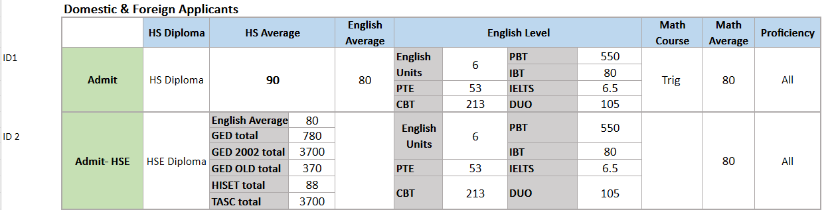
Baruch Freshman Admit Rules A ID1, ID2

Slide 5
Freshman Admit Rule A Rule ID 1
HS_DIPLOMA = Y
AND HS_AVERAGE_GPA >= 85
AND HS_AVERAGE_GPA_ENGL >= 80
AND ( HS_TOTAL_UNITS_ENGLISH >= 6 OR TEST_TOEFL_IBT_SCORE >= 80 OR
TEST_TOEFL_PBT_SCORE >= 550 OR TEST_TOEFL_CBT_SCORE >= 213 OR TEST_PTE_SCORE >=
53 OR TEST_IELTS_SCORE >= 6.5 OR TEST_DUOLINGO_SCORE >= 105 )
AND HS_MATH_LVL_GE_TRIGONOMETRY = Y
AND HS_AVERAGE_GPA_MATH >= 80
AND PROFICIENT_ALL = Y
Notes:
This rule looks at both domestic and international students since TOEFL scores can be used to replace English units. However, many international students do not have English subject GPA, which is required here. For international students, this rule excludes applicants from non-English speaking countries because they do not receive English subject average in evaluation.

Slide 6
Freshman Admit Rule A Rule ID 2
HSE_DIPLOMA = Y
AND ( TEST_GED_TOTAL >= 740 OR TEST_GED_TOTAL_2002_SERIES >= 3500 OR
TEST_GED_TOTAL_OLD_SERIES >= 350 OR TEST_TASC_TOTAL >= 3500 OR
TEST_HISET_TOTAL >= 83 ) OR HS_AVERAGE_GPA_ENGL >= 80
AND ( HS_TOTAL_UNITS_ENGLISH >= 6
AND TEST_TOEFL_IBT_SCORE >= 80 OR TEST_TOEFL_PBT_SCORE >= 550 OR
TEST_TOEFL_CBT_SCORE >= 213 OR TEST_PTE_SCORE >= 53 OR TEST_IELTS_SCORE >= 6.5
OR TEST_DUOLINGO_SCORE >= 105 )
AND HS_AVERAGE_GPA_MATH >= 80
AND PROFICIENT_ALL = Y First Slide
Notes:
Rule ID 2 seems to be for students who have taken the GED diploma or international student who has chosen to take the GED. The rule requires 6 units of English. Some GED applicants and international students do not have a regular English subject units. Some GED applicants do not have a regular math subject average. GED math section score is different from the math subject average. This rule requires GED applicants to have TOEFL scores. It is not clear whether this rule was meant for GED applicant or international applicant. This parenthesis ) may need to be placed after HS_AVERAGE_GPA >=80.

Slide 7
Brooklyn

Slide 8
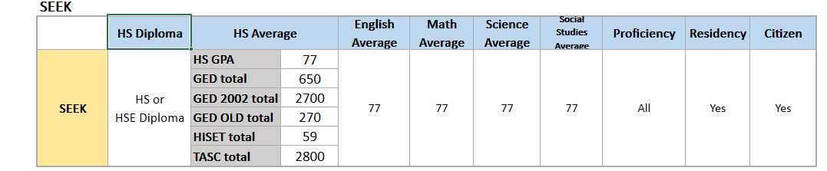
Brooklyn SEEK Rules

Slide 9
SEEK Admit Rule ID 1
RESIDENCY = Y
AND CITIZENSHIP_STATUS = Y
AND ( HS_DIPLOMA = Y OR HSE_DIPLOMA = Y )
AND ( HS_AVERAGE_GPA >= 77 OR HSE_DIPLOMA = Y OR TEST_GED_TOTAL >=650
OR TEST_GED_TOTAL_2002_SERIES >= 2700 OR TEST_GED_TOTAL_OLD_SERIES >=
270 OR TEST_HISET_TOTAL >= 59 OR TEST_TASC_TOTAL >= 2800 )
AND HS_AVERAGE_GPA_ENGL >= 77
AND HS_AVERAGE_GPA_MATH >= 77
AND HS_AVERAGE_GPA_SOCS >= 77
AND HS_AVERAGE_GPA_SCI >= 77
AND PROFICIENT_ALL = Y First Slide
Notes:
SEEK RULE ID allows applicants to replace the GED scores with a HSE diploma. Do you want to admit all GED students with a diploma or do you want to require certain GED scores? Moreover, this rule requires all GED applicants to have Social Studies, Science, Math, English averages. Most GED applicants do not have regular high school credentials. The criteria for the GED and regular HS diploma applicants should be properly separated. Suggestion:
RESIDENCY = Y AND CITIZENSHIP_STATUS = Y AND ( (HS_DIPLOMA =Y AND HS_AVERAGE_GPA>=77 AND
HS_AVERAGE_GPA_ENGL>=77 AND HS_AVERAGE_GPA_MATH>=77 AND HS_AVERAGE_SOCS>=77 AND
HS_AVERAGE_SCI>=77) OR (HSE DIPLOMA= Y AND (TEST_GED_TOTAL>=650 OR TEST_GED_TOTAL
_2002_SERIES>= 2700 OR TEST_GED_TOTAL _OLD_SERIES>=270 OR TEST_HISET_TOTAL>=59 OR
TEST_TASC>=2800) ) ) AND PROFICIENCY_ALL=Y

Slide 10
BMCC

Slide 11
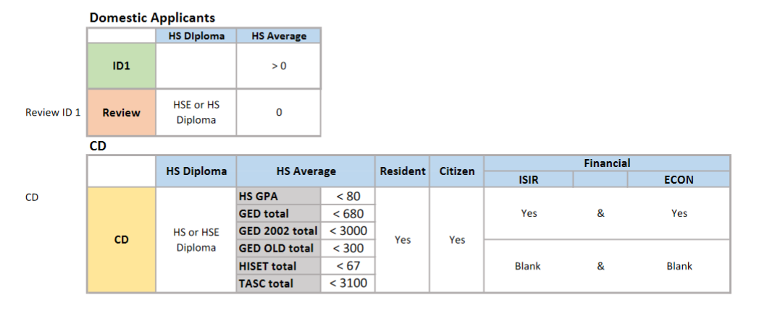
BMCC Freshman Rules

Slide 12
Freshman Admit Rule ID 1
HS_AVERAGE_GPA > 0
Notes:
This Rule ID 1 does not verify the presence of high school diploma. UAPC does not code high school diploma for hs diploma earned from a nonaccredited high schools. Rule ID 1 accepts all students regardless of accreditation status. Is this what you intended? Similar situation for the Freshman review rule below.

Slide 13
Freshman Review Rule ID 1
HS_AVERAGE_GPA = 0 OR HSE_DIPLOMA = Y OR HS_DIPLOMA = Y
Notes:
It makes the high school diploma optional if high school average is present. Right now, UAPC evaluates all high school records and gives the student average regardless of accreditation. For a student from nonaccredited high schools, the evaluators enter high school average without the diploma.

Slide 14
CD Admit Rule ID 1
( CITIZENSHIP_STATUS = Y AND RESIDENCY = Y ) AND ( ( APPLICANT_ISIR_LOADED = Y AND ECON_GUIDELINES = Y ) OR APPLICANT_ISIR_LOADED <> Y ) AND ( HS_DIPLOMA = Y OR HSE_DIPLOMA = Y ) AND ( HS_AVERAGE_GPA < 80 OR TEST_HISET_TOTAL < 67 OR TEST_GED_TOTAL_2002_SERIES < 3000 OR TEST_GED_TOTAL_OLD_SERIES < 300 OR TEST_GED_TOTAL < 680 OR TEST_TASC_TOTAL < 3100 )
First Slide
Notes:
This criteria in red is not necessary. Freshman Admit Rule ID 1 accepts all students with a 0+ high school average.

Slide 15
CSI
Many of CSI rules do not require high school diploma but simply looks at high school average or GED scores instead. At this time, UAPC evaluates ALL high school transcripts regardless of accreditation status. We enter high school average for nonaccredited OrgID. We differentiate between accredited and nonaccredited by coding or not coding high school degree. Not requiring high school diploma would admit all high school students from all institutions. Is this what you intended?

Slide 16
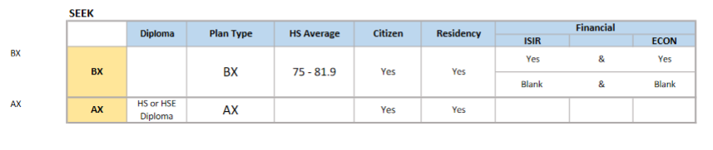
SEEK Admit Rule BX Rule ID
( CITIZENSHIP_STATUS = Y AND RESIDENCY = Y ) AND ( ( APPLICANT_ISIR_LOADED = Y AND ECON_GUIDELINES = Y ) OR APPLICANT_ISIR_LOADED <> Y ) AND PLAN_CSI01_BX = Y AND HS_AVERAGE_GPA >= 75 AND HS_AVERAGE_GPA < 82
Notes:
No high school degree

Slide 17
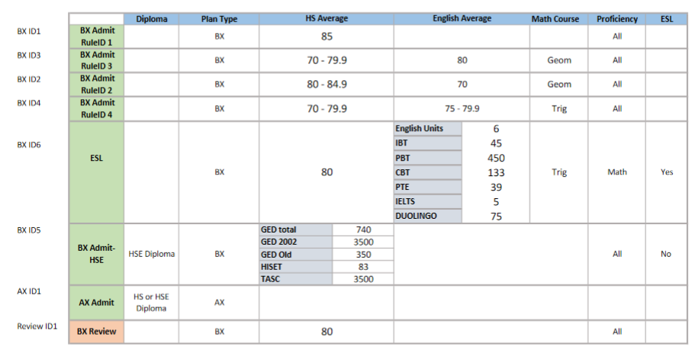
CSI Freshman Rules

Slide 18
Freshman Admit Rule BX Rule ID 1
PLAN_CSI01_BX = Y AND HS_AVERAGE_GPA >= 85 AND PROFICIENT_ALL = Y
Notes:
No high school degree

Slide 19
Freshman Admit Rule BX Rule ID 2
PLAN_CSI01_BX = Y AND ( HS_AVERAGE_GPA >= 80 AND HS_AVERAGE_GPA < 85 ) AND HS_AVERAGE_GPA_ENGL >= 70 AND HS_MATH_LVL_GE_GEOMETRY = Y AND PROFICIENT_ALL = Y
Notes:
No high school degree

Slide 20
Freshman Admit Rule BX Rule ID 3
PLAN_CSI01_BX = Y AND ( HS_AVERAGE_GPA >= 70 AND HS_AVERAGE_GPA < 80 ) AND HS_AVERAGE_GPA_ENGL >= 80 AND HS_MATH_LVL_GE_GEOMETRY = Y AND PROFICIENT_ALL = Y
Notes:
No high school degree

Slide 21
Freshman Admit Rule BX Rule ID 4
PLAN_CSI01_BX = Y AND ( HS_AVERAGE_GPA >= 70 AND HS_AVERAGE_GPA < 80 ) AND ( HS_AVERAGE_GPA_ENGL >= 75 AND HS_AVERAGE_GPA_ENGL < 80 ) AND HS_MATH_LVL_GE_TRIGONOMETRY = Y AND PROFICIENT_ALL = Y
Notes:
No high school degree

Slide 22
Freshman Admit Rule BX Rule ID 5
PLAN_CSI01_BX = Y AND HSE_DIPLOMA = Y AND ( TEST_GED_TOTAL >= 740 OR TEST_GED_TOTAL_2002_SERIES >= 3500 OR TEST_GED_TOTAL_OLD_SERIES >= 350 OR TEST_HISET_TOTAL >= 83 OR TEST_TASC_TOTAL >= 3500 ) AND SERVICE_INDICATOR_ESL <> Y AND PROFICIENT_ALL = Y
First Slide
Notes:
Some ESL/international students take the GED. This criteria would exclude international students who take GED. RuleID 6 is written for ESL applicants, but rule ID 6 does not consider GED scores.

Slide 23
City

Slide 24
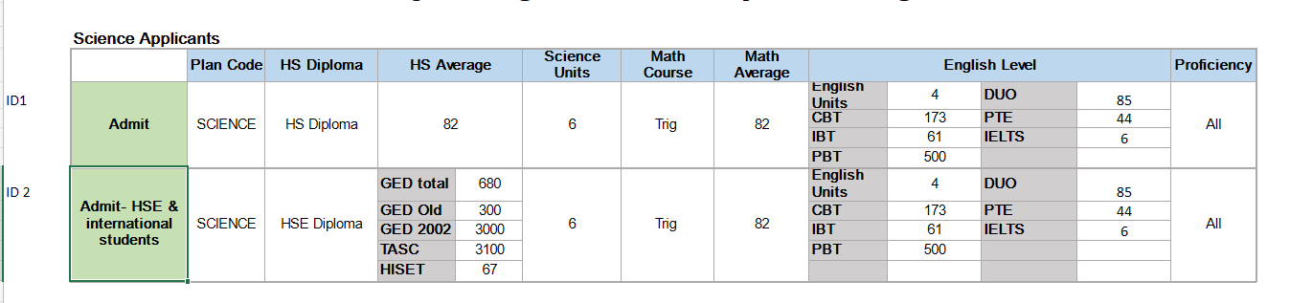
City Freshman Rules

Slide 25
Freshman Admit Rule- SCI Rule ID 2
PLAN_CTY01_SCIENCE = Y
AND HSE_DIPLOMA = Y
AND ( TEST_HISET_TOTAL >= 67 OR TEST_GED_TOTAL >= 680 OR TEST_GED_TOTAL_OLD_SERIES >=
300 OR TEST_TASC_TOTAL >= 3100 OR TEST_GED_TOTAL_2002_SERIES >= 3000 ) AND HS_MATH_LVL_GE_TRIGONOMETRY = Y
AND HS_AVERAGE_GPA_MATH >= 82
AND ( HS_TOTAL_UNITS_ENGLISH >= 4 OR TEST_TOEFL_CBT_SCORE >= 73
OR TEST_TOEFL_IBT_SCORE >= 61 OR TEST_TOEFL_PBT_SCORE >=
500 OR TEST_DUOLINGO_SCORE >= 85 OR TEST_PTE_SCORE >= 44 OR TEST_IELTS_SCORE >= 6 )
AND HS_TOTAL_UNITS_SCIENCE >= 6
AND PROFICIENT_ALL = Y First Slide
Notes:
Rule ID 2 seems to be written for both GED and international applicants.
From regular GED applicant’s point of view, this rule requires 4 units of English because they normally do not take the TOEFL. Many GED applicants do not have regular English subject units unless they attended a regular high school initially. Also, many GED applicants may not have taken the Trigonometry course or have subject average for Math.
From the international student’s point of view, this rule requires that the international students have GED diploma. In addition, this rule requires that they be proficient in Reading and Writing (proficiency = ALL). If the proficiency index takes the TOEFL scores into consideration, this rule is fine. However, PI index only looks at secondary school classes. PI index does not get calculated if the student has ESL indicator. It seems best to separate this rule into GED and international rules. I have observed in other colleges’ rules that International rule normally requires Math proficiency and TOEFL scores, not all proficiency. Freshman Rule ID 1 and 2 should be revisited for Liberal Arts, Science, Architecture, and Engineering.
CBT scores is incorrect in Freshman Admit Rule- CSI, ENGG, ARCH ID 1,2

Slide 26
Hunter

Slide 27
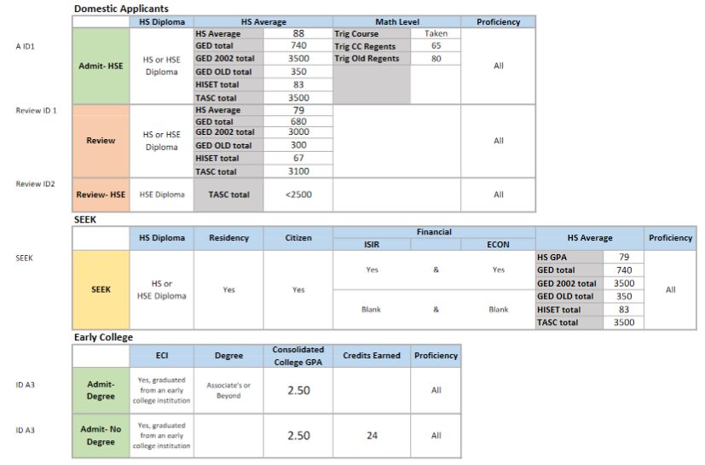
Hunter Freshman Rules

Slide 28
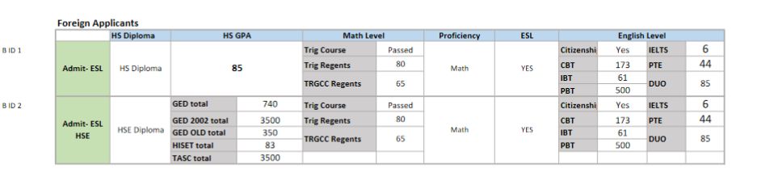
Hunter Freshman Rules

Slide 29
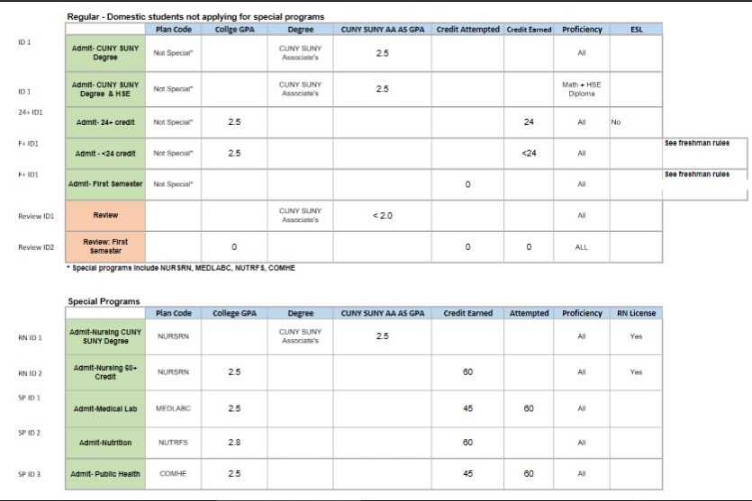
Hunter Transfer Rules

Slide 30
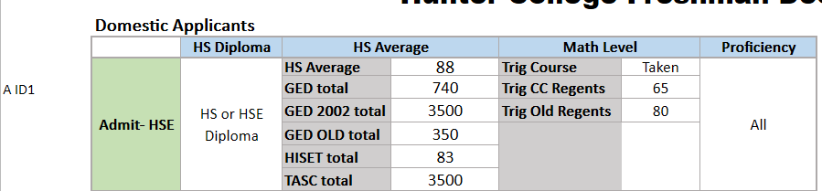

Slide 31
Freshman Admit Rule A- Gen/Intl Rule ID 1
( HS_DIPLOMA = Y OR HSE_DIPLOMA = Y )
AND ( HS_AVERAGE_GPA >= 88 OR TEST_GED_TOTAL >=
740 OR TEST_GED_TOTAL_2002_SERIES >= 3500 OR
TEST_GED_TOTAL_OLD_SERIES >=350 OR
TEST_HISET_TOTAL >= 83 OR TEST_TASC_TOTAL >= 3500 )
AND ( HS_MATH_LVL_GE_TRIGONOMETRY = Y OR
TEST_REGENTS_MATH_TRIG >= 80 OR
TEST_REGENTS_MATH_TRGCC >= 65 )
AND PROFICIENT_ALL = Y
Notes:
This rules looks at both regular high school and GED applicants. This rule requires GED applicants to have taken trigonometry subject or Trig regents.

Slide 32
Freshman Admit Rule A- Gen/Intl Rule ID 2
APPLICANT_ECI = Y
AND ( ( COLLEGE_DEGREE_ASSOCIATE >= Y AND
COLLEGE_GPA_CONSOLIDATED >= 2.5 ) OR
( COLLEGE_TOTAL_CRED_EARNED >= 24 AND
COLLEGE_GPA_CONSOLIDATED >= 2.5 ) ) AND PROFICIENT_ALL = Y
Notes:
What is greater than Yes/truth? Did not make logical sense. Perhaps > needs to be dropped.

Slide 33
Transfer Admit Rule General Rule ID 1
( PLAN_APPL <> NURSRN-BS AND PLAN_APPL <> MEDLABC-BS AND PLAN_APPL <> NUTRFS-BS AND PLAN_APPL <> COMHE-BS ) AND COLLEGE_DEGREE_CUNY_SUNY_AA_AS >= 2.5 AND PROFICIENT_MATH = Y AND ( ( PROFICIENT_READ = Y AND PROFICIENT_WRIT = Y ) OR ( SERVICE_INDICATOR_ESL = Y AND CITIZENSHIP_STATUS <> Y AND ( TEST_IELTS_SCORE >= 6 OR TEST_PTE_SCORE >= 44 OR TEST_TOEFL_CBT_SCORE >= 173 OR TEST_TOEFL_PBT_SCORE >= 500 OR TEST_TOEFL_IBT_SCORE >= 61 ) OR HSE_DIPLOMA = Y ) )
Notes:
Missing Duolingo.

Slide 34
Transfer Admit Rule >= 24cr Rule ID 2
SERVICE_INDICATOR_ESL = Y AND CITIZENSHIP_STATUS <> Y AND PROFICIENT_MATH = Y AND ( PLAN_APPL <> NURSRN-BS AND PLAN_APPL <> MEDLABC-BS AND PLAN_APPL <> NUTRFS-BS AND PLAN_APPL <> COMHE-BS ) AND ( COLLEGE_TOTAL_CRED_EARNED >= 24 AND COLLEGE_GPA_CONSOLIDATED >= 2.5 ) AND ( TEST_IELTS_SCORE >= 6 OR TEST_PTE_SCORE >= 44 OR TEST_TOEFL_CBT_SCORE >= 173 OR TEST_TOEFL_IBT_SCORE >= 61 OR TEST_TOEFL_PBT_SCORE >= 500 OR ( PROFICIENT_READ = Y AND PROFICIENT_WRIT = Y ) OR HSE_DIPLOMA = Y ) First Slide
Notes:
Duolingo is missing

Slide 35
John Jay

Slide 36
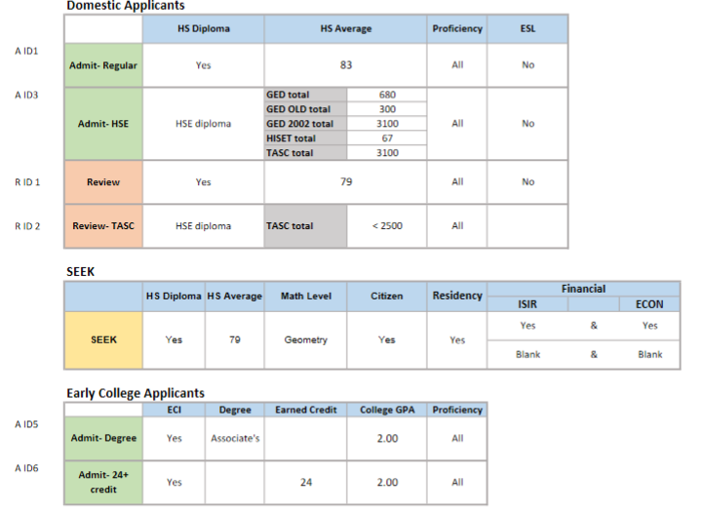
John Jay Freshman Rules

Slide 37
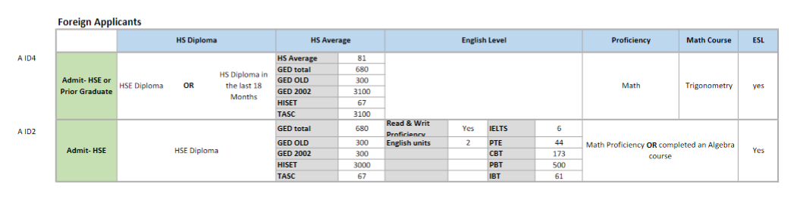
John Jay Freshman Rules

Slide 38
Freshman Admit Rule A Rule ID 2
HSE_DIPLOMA = Y
AND ( TEST_GED_TOTAL >= 680 OR TEST_GED_TOTAL_2002_SERIES >=
3000 OR TEST_GED_TOTAL_OLD_SERIES >= 300 OR TEST_HISET_TOTAL >=
67 OR TEST_TASC_TOTAL >= 3100 )
AND SERVICE_INDICATOR_ESL = Y
AND ( ( PROFICIENT_READ = Y AND PROFICIENT_WRIT = Y ) OR ( HS_TOTAL_UNITS_ENGLISH >= 2 OR TEST_IELTS_SCORE >= 6 OR TEST_PTE_SCORE >= 44 OR TEST_TOEFL_CBT_SCORE >=
173 OR TEST_TOEFL_PBT_SCORE >= 500 OR TEST_TOEFL_IBT_SCORE >= 61 ) )
AND ( HS_MATH_LVL_GE_ALGEBRA = Y OR PROFICIENT_MATH = Y )
Notes:
This seems to be a rule written for international students for the ESL indicator is Yes and it considers TOEFL. This rule requires that the international students have the GED diploma and scores. Maybe the top section can include ‘HS_diploma = Y or HSE_diploma=Y’ and high school average can be included in the second section with an OR. This rule is also missing Duolingo scores.

Slide 39
Freshman Admit Rule ID 4
HS_MATH_LVL_GE_TRIGONOMETRY = Y
AND HS_GRADUATION_DATE_18_MONTHS <> Y
AND SERVICE_INDICATOR_ESL = Y
AND ( HSE_DIPLOMA = Y OR HS_GRADUATION_DATE_18_MONTHS = Y )
AND PROFICIENT_ALL = Y
AND ( TEST_GED_TOTAL >= 680 OR TEST_GED_TOTAL_OLD_SERIES >=
300 OR TEST_GED_TOTAL_2002_SERIES >= 3100 OR TEST_HISET_TOTAL >= 67 OR TEST_TASC_TOTAL >= 3100 OR HS_AVERAGE_GPA >= 81 )
AND PROFICIENT_MATH = Y First Slide
Notes:
It is not clear whether this rule is written for GED applicants or foreign applicants. The ESL indicator is present without the consideration of the TOEFL scores. Also HS Graduation Date 18 months is required as No earlier and later Yes. This rule needs more clarification.

Slide 40
LaGuardia

Slide 41
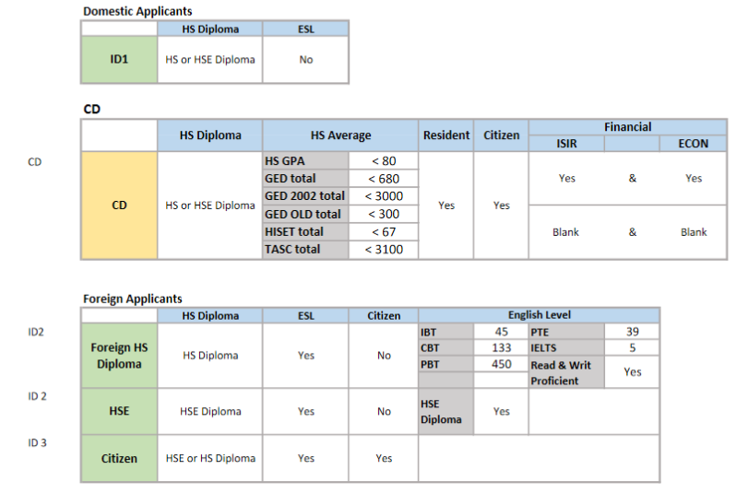
LaGuardia Freshman Rules

Slide 42
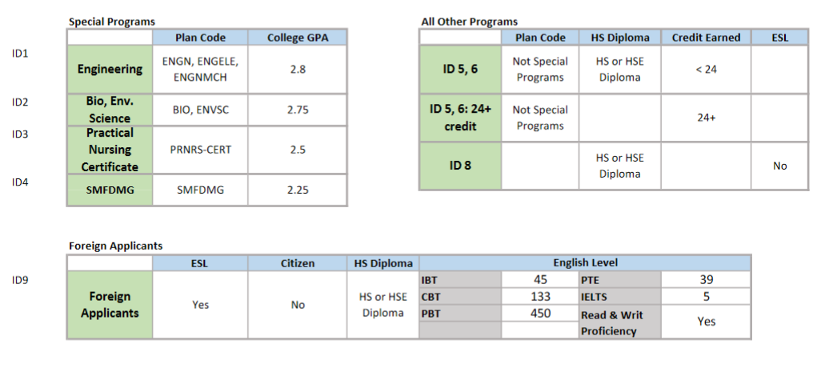
LaGuardia Transfer

Slide 43
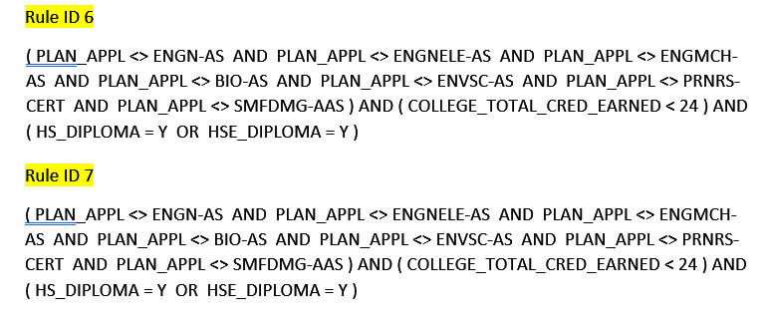
Transfer Admit Rule ID 6 & 7
Notes:
Rule ID6 & 7 seem to be identical. One can be deleted.

Slide 44
Transfer Admit Rule ID 8
SERVICE_INDICATOR_ESL <> Y AND ( HS_DIPLOMA = Y OR HSE_DIPLOMA = Y )
Notes:
This rule may accept every Transfer applicant with a high school diploma. This might be going against the Rule ID1, 2, 3, 4 that requires certain GPA for certain programs. This rule needs to exclude applicants engineering, biology, nursing etc.

Slide 45
Transfer Admit Rule ID 9
SERVICE_INDICATOR_ESL = Y AND CITIZENSHIP_STATUS <> Y AND ( HS_DIPLOMA = Y OR HSE_DIPLOMA = Y ) AND ( ( TEST_TOEFL_CBT_SCORE >= 133 OR TEST_TOEFL_PBT_SCORE >= 450 OR TEST_TOEFL_IBT_SCORE >= 45 OR TEST_IELTS_SCORE >= 5 OR TEST_PTE_SCORE >= 39 ) OR ( PROFICIENT_READ = Y AND PROFICIENT_WRIT = Y ) )
Notes:
Missing DUOLINGO

Slide 46
Freshman Admit Rule ID 2
SERVICE_INDICATOR_ESL = Y AND CITIZENSHIP_STATUS <> Y AND ( HS_DIPLOMA = Y OR HSE_DIPLOMA = Y ) AND ( ( TEST_TOEFL_CBT_SCORE >= 133 OR TEST_TOEFL_PBT_SCORE >= 450 OR TEST_TOEFL_IBT_SCORE >= 45 OR TEST_IELTS_SCORE >= 5 OR TEST_PTE_SCORE >= 39 ) OR ( PROFICIENT_READ = Y AND PROFICIENT_WRIT = Y ) OR HSE_DIPLOMA = Y )
First Slide
Notes:
Missing DUOLINGO

Slide 47
Lehman

Slide 48
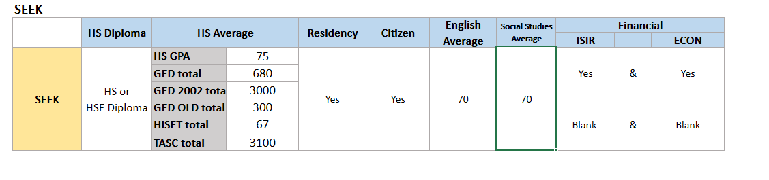
Lehman Freshman Rules

Slide 49
SEEK Admit Rule ID 1
( CITIZENSHIP_STATUS = Y AND RESIDENCY = Y )
AND ( ( APPLICANT_ISIR_LOADED = Y AND ECON_GUIDELINES = Y ) OR
APPLICANT_ISIR_LOADED <> Y )
AND ( HS_DIPLOMA = Y OR HSE_DIPLOMA = Y )
AND ( HS_AVERAGE_GPA >= 75 OR TEST_GED_TOTAL >= 680 OR
TEST_GED_TOTAL_2002_SERIES >= 3000 OR
TEST_GED_TOTAL_OLD_SERIES >= 300 OR TEST_HISET_TOTAL >= 67 OR
TEST_TASC_TOTAL >= 3100 )
AND HS_AVERAGE_GPA_ENGL >= 70
AND HS_AVERAGE_GPA_SOCS >= 70 First Slide
Notes:
This SEEK rule excludes all GED applicants who may not have SOCS and English subject averages.

Slide 50
Medgar Evers

Slide 51
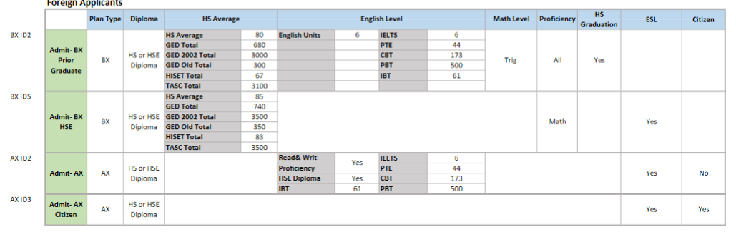
Medgar Evers Foreign Applicant Rules

Slide 52
Freshman Admit Rule AX Rule ID 2
SERVICE_INDICATOR_ESL = Y
AND CITIZENSHIP_STATUS <> Y
AND PLAN_MEC01_AX = Y
AND ( HSE_DIPLOMA = Y OR HS_DIPLOMA = Y )
AND ( TEST_IELTS_SCORE >= 6 OR TEST_PTE_SCORE >= 44 OR TEST_TOEFL_CBT_SCORE >= 173 OR TEST_TOEFL_PBT_SCORE >= 500 OR TEST_TOEFL_IBT_SCORE >= 61 OR ( PROFICIENT_READ = Y AND PROFICIENT_WRIT = Y ) OR HSE_DIPLOMA = Y )
Notes:
Missing Duolingo.

Slide 53
Freshman Admit Rule BX Rule ID 2
( PLAN_MEC01_BX = Y )
AND ( HSE_DIPLOMA = Y OR HS_DIPLOMA = Y )
AND ( HS_AVERAGE_GPA >= 80 OR TEST_GED_TOTAL >= 680 OR TEST_GED_TOTAL_2002_SERIES >= 3000 OR TEST_GED_TOTAL_OLD_SERIES >= 300 OR TEST_HISET_TOTAL >= 67 OR TEST_TASC_TOTAL >= 3100 )
AND HS_MATH_LVL_GE_TRIGONOMETRY = Y
AND ( HS_TOTAL_UNITS_ENGLISH >= 6 OR TEST_IELTS_SCORE >= 6 OR TEST_PTE_SCORE >= 44 OR TEST_TOEFL_CBT_SCORE >= 173 OR TEST_TOEFL_PBT_SCORE >= 500 OR TEST_TOEFL_IBT_SCORE >= 61 OR ( HS_GRADUATION_DATE_18_MONTHS = Y )
AND PROFICIENT_ALL = Y )
Notes:
This rule does not have an ESL indicator but it still considers international applications with TOEFL scores. If this rule is written for international applicants, Duolingo is missing as well. Also, most international applicants would not have PROFICIENT_ALL = Y. Usually, international rules with this pattern: math proficiency, ESL indicator, and TOEFL scores.
This rule needs clarification whether it is for international students or for GED applicants.

Slide 54
Freshman Admit Rule BX Rule ID 5
( ( PLAN_MEC01_BX = Y )
AND ( HSE_DIPLOMA = Y OR HS_DIPLOMA = Y )
AND ( HS_AVERAGE_GPA >= 85 OR TEST_GED_TOTAL >= 740 OR TEST_GED_TOTAL_2002_SERIES >= 3500 OR TEST_GED_TOTAL_OLD_SERIES >= 350 OR TEST_HISET_TOTAL >= 83 OR TEST_TASC_TOTAL >= 3500 )
AND ( SERVICE_INDICATOR_ESL = Y )
AND PROFICIENT_MATH = Y ) First Slide
Notes:
This rule seems to have been written for international applicants due to the presence of ESL indicator and math proficiency. I found it odd that this rule only considers GED scores. I wonder whether there was a mix-up between the Rule ID2 and this one. They may need to be revisited.

Slide 55
City Tech

Slide 56
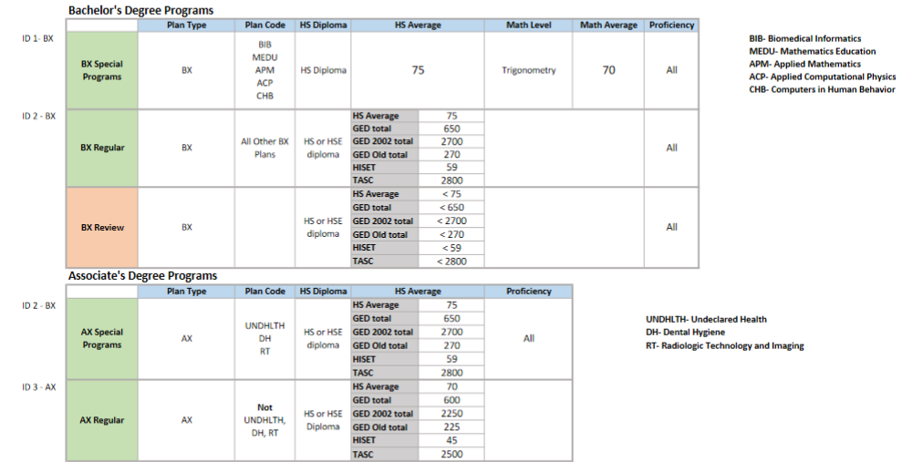
City Tech Freshman Rules

Slide 57
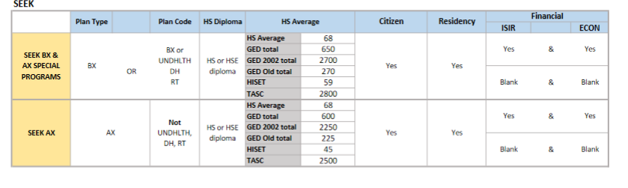
City Tech Freshman Rules

Slide 58
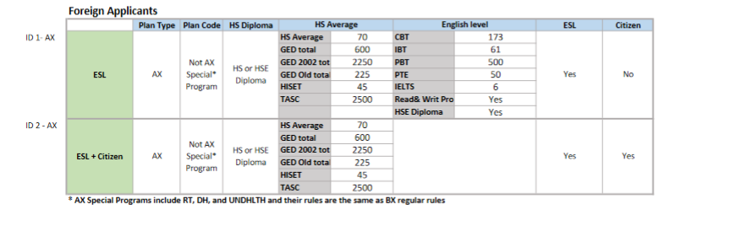
City Tech Freshman Rules

Slide 59
Freshman admit Rule AX Rule ID 1
SERVICE_INDICATOR_ESL = Y AND CITIZENSHIP_STATUS <> Y AND PLAN_NYT01_AX = Y AND PLAN_APPL <> DH-AAS AND PLAN_APPL <> UNDHLTH-AA AND PLAN_APPL <> RT-AAS AND ( HSE_DIPLOMA = Y OR HS_DIPLOMA = Y ) AND ( HS_AVERAGE_GPA >= 70 OR TEST_HISET_TOTAL >= 45 OR TEST_GED_TOTAL_2002_SERIES >= 2250 OR TEST_GED_TOTAL_OLD_SERIES >= 225 OR TEST_GED_TOTAL >= 600 OR TEST_TASC_TOTAL >= 2500 ) AND ( ( TEST_TOEFL_CBT_SCORE >= 173 OR TEST_TOEFL_IBT_SCORE >= 61 OR TEST_TOEFL_PBT_SCORE >= 500 OR TEST_PTE_SCORE >= 50 OR TEST_IELTS_SCORE > 6 ) OR ( PROFICIENT_READ = Y AND PROFICIENT_WRIT = Y ) OR HSE_DIPLOMA = Y )
Notes:
Missing duolingo. City tech does not have a rule for ESL Freshman applicant to BX programs. Did you intend to accept international students only for AX programs?

Slide 60
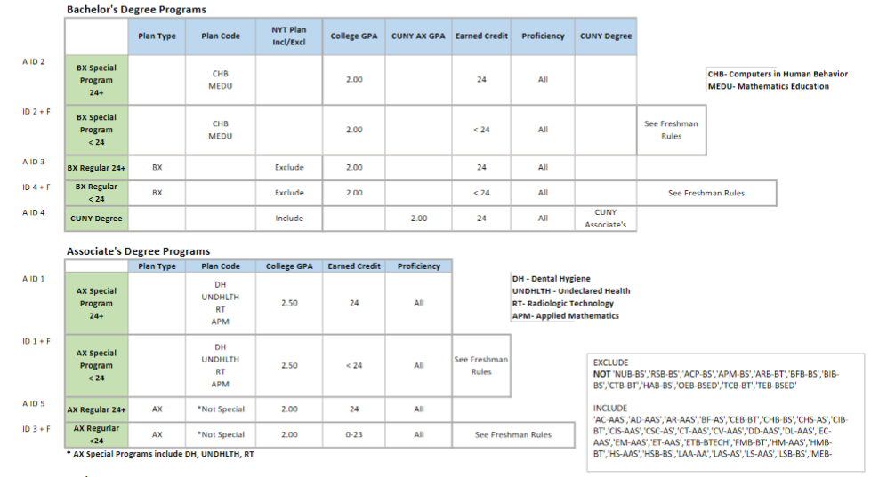
City Tech Transfer Rules

Slide 61
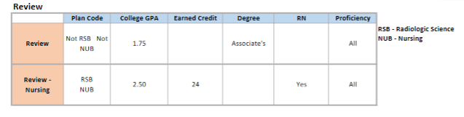
City Tech Transfer Rules
First Slide
Notes:
City Tech does not have a rule that reviews first semester Transfer applicants

Slide 62
Hostos

Slide 63
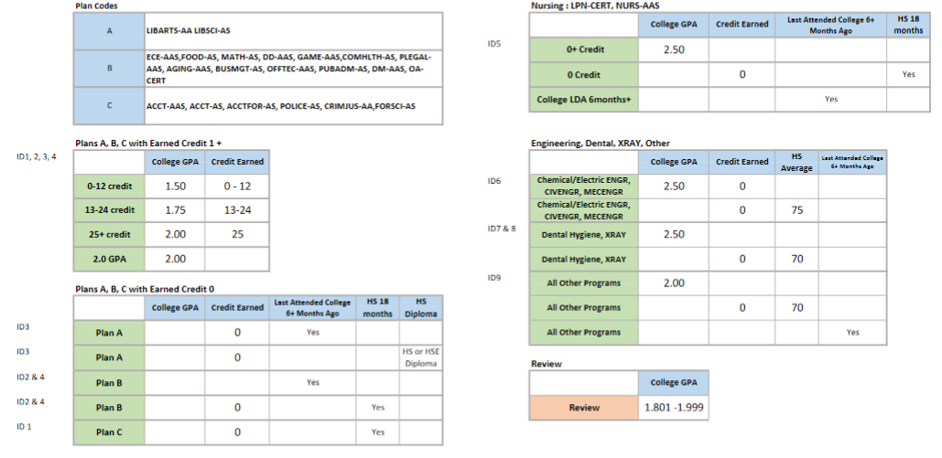
Hostos Transfer Rules

Slide 64
Transfer Admit Rule ID 9
( COLLEGE_GPA_CONSOLIDATED >= 2.00 )
OR ( COLLEGE_TOTAL_CRED_EARNED = 0.0 AND HS_AVERAGE_GPA >= 70 )
OR ( COLLEGE_LDA_GE_6M = Y )
Notes:
Rule ID 9 may need to exclude engineering, Chemical/Electric ENGR, CIVENGR, MECENGR, Dental hygiene, x-Ray because they have higher GPA requirement of 2.5. Rule ID 9 may be enabling applicants with just 2.0 or high school average of 70 to be accepted to these more competitive programs.

Slide 65
Transfer Admit Rule ID 1, 2, 3, 4
( PLAN_APPL = ACCT-AAS OR PLAN_APPL = ACCT-AS OR PLAN_APPL = ACCTFOR-AS OR PLAN_APPL = POLICE-AS OR PLAN_APPL = CRIMJUS-AA OR PLAN_APPL = FORSCI-AS ) AND ( ( COLLEGE_GPA_CONSOLIDATED >= 1.50 AND COLLEGE_TOTAL_CRED_EARNED >= 0 AND COLLEGE_TOTAL_CRED_EARNED <= 12 ) OR ( COLLEGE_GPA_CONSOLIDATED >= 1.75 AND COLLEGE_TOTAL_CRED_EARNED >= 13.0 AND COLLEGE_TOTAL_CRED_EARNED <= 24 ) OR ( COLLEGE_GPA_CONSOLIDATED >= 2.00 AND COLLEGE_TOTAL_CRED_EARNED >= 25 ) OR ( COLLEGE_GPA_CONSOLIDATED >= 2.00 ) OR ( COLLEGE_TOTAL_CRED_EARNED = 0.0 AND HS_GRADUATION_DATE_18_MONTHS = Y ) ) First Slide
Notes:
These rules are almost identical except for the list of majors. These rules may be combined into just one rule. There is no logical mistake, but these rules 1, 2, 3, 4 can be clearer.

Slide 66
Queens

Slide 67
Freshman Admit Rule ID 2
SERVICE_INDICATOR_ESL = Y AND CITIZENSHIP_STATUS <> Y AND HS_AVERAGE_GPA >= 87 AND HS_TOTAL_UNITS_SCIENCE >= 4 AND HS_MATH_LVL_GE_TRIGONOMETRY = Y AND PROFICIENT_MATH = Y AND ( TEST_TOEFL_CBT_SCORE >= 173 OR TEST_TOEFL_PBT_SCORE >= 500 OR TEST_TOEFL_IBT_SCORE >= 61 OR TEST_IELTS_SCORE >= 6 OR TEST_PTE_SCORE >= 44 OR ( PROFICIENT_READ = Y AND PROFICIENT_WRIT = Y ) OR HSE_DIPLOMA = Y )
First Slide
Notes:
The rule is missing Duolingo option for foreign applicants. The Duolingo option
should be included in Transfer Admit Rule ID1, Transfer Admit Rule ID2, and Transfer Admit Rule ID3.

Slide 68
SPS

Slide 69
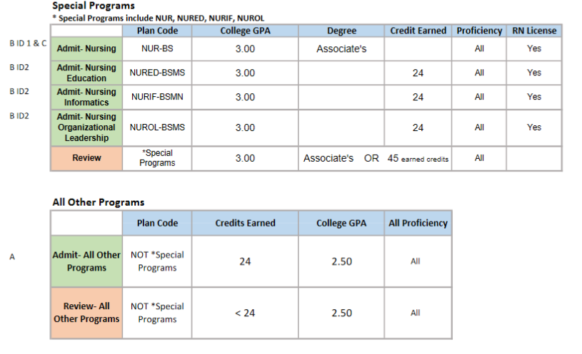
Transfer Rules

Slide 70
Transfer Admit Rule B & Transfer Admit Rule C
Rule B
LICENSE_RN = Y
AND PLAN_APPL = NUR-BS
AND COLLEGE_DEGREE_ASSOCIATE = Y
AND COLLEGE_GPA_CONSOLIDATED > 3.00
AND PROFICIENT_ALL = Y
Rule C
( COLLEGE_DEGREE_ASSOCIATE = Y
AND LICENSE_RN = Y
AND PLAN_APPL = NUR-BS
AND COLLEGE_GPA_CONSOLIDATED >= 3.0 )
AND PROFICIENT_ALL = Y First Slide
Notes:
These rules contain duplicate information. Rule B can be updated to include “=” and Rule C can be eliminated. Or keep C and discard B.

Slide 71
York

Slide 72
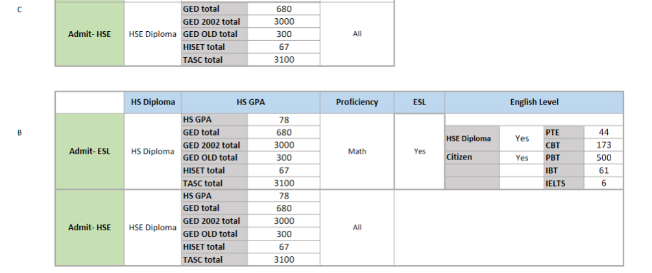
Freshman Rules C & B

Slide 73
Freshman Admit Rule B Rule ID 1
( HSE_DIPLOMA = Y AND HS_DIPLOMA = Y )
AND ( HS_AVERAGE_GPA >= 78 OR TEST_GED_TOTAL >= 680 OR TEST_GED_TOTAL_2002_SERIES >= 3000 OR TEST_GED_TOTAL_OLD_SERIES >= 300 OR TEST_HISET_TOTAL >= 67 OR TEST_TASC_TOTAL >= 3100 )
AND PROFICIENT_MATH = Y
AND ( ( PROFICIENT_READ = Y AND PROFICIENT_WRIT = Y )
OR ( SERVICE_INDICATOR_ESL = Y AND ( TEST_IELTS_SCORE >= 6 OR TEST_PTE_SCORE >= 44 OR TEST_TOEFL_PBT_SCORE >= 500 OR T EST_TOEFL_CBT_SCORE >= 173 OR TEST_TOEFL_IBT_SCORE >= 61 OR HSE_DIPLOMA = Y OR CITIZENSHIP_STATUS = Y ) ) )
Notes:
This rule seems to consider both GED and international applicants. This rule requires GED applicants to also have a regular HS diploma.
Suggestion: Remove all GED requirements from Rule B because the same rule is already present in the
Freshman Admit Rule C. The Rule B should be cleaned up to only consider applicants with ESL indicators.
The rule is also missing Duolingo option for foreign applicants. York Transfer Rules ID 1, 2, 3, 4 also need Duolingo scores.

Slide 74
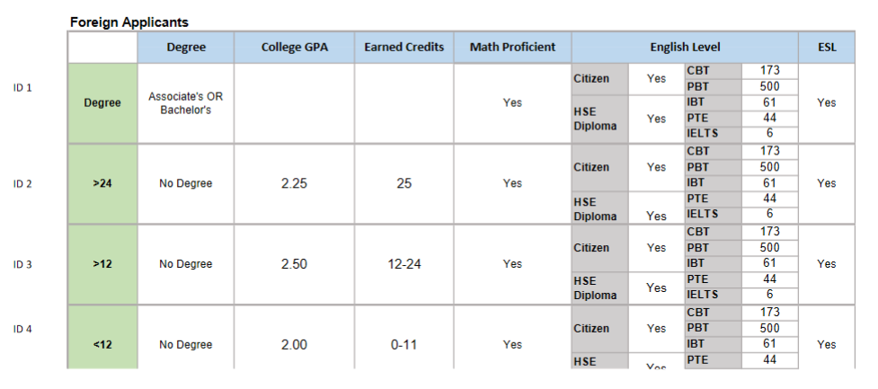
Transfer Rules for International Students

Slide 75
Freshman Admit Rule C ID 1
HSE_DIPLOMA = Y
AND ( TEST_GED_TOTAL >= 680 OR TEST_GED_TOTAL_2002_SERIES
>= 3000 OR TEST_GED_TOTAL_OLD_SERIES >= 300 OR TEST_HISET_TOTAL >= 67 OR TEST_TASC_TOTAL >= 3100 )
AND PROFICIENT_ALL = Y
First Slide
Notes:
This slide is to show that the GED rule already exists. Therefore, GED rules can be eliminated from Rule B, the previous slide. This rule also considers international applicants who have taken the GED.

